Slide 1
Citi Bike Analysis – 2017
Bill Magill

Slide 2
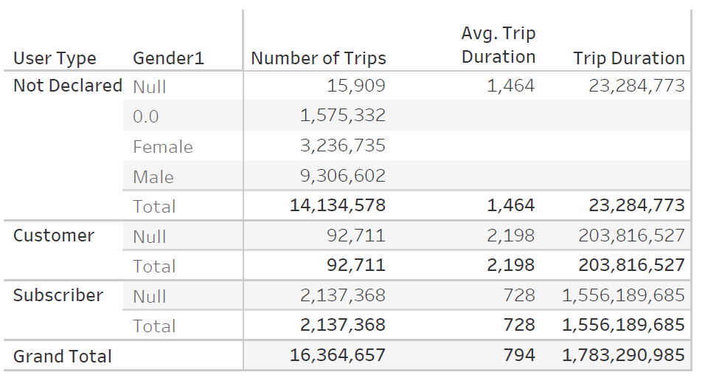
2017 Rides
Over 16 million rides in 2017
Average trip of 13.3 minutes

Slide 3
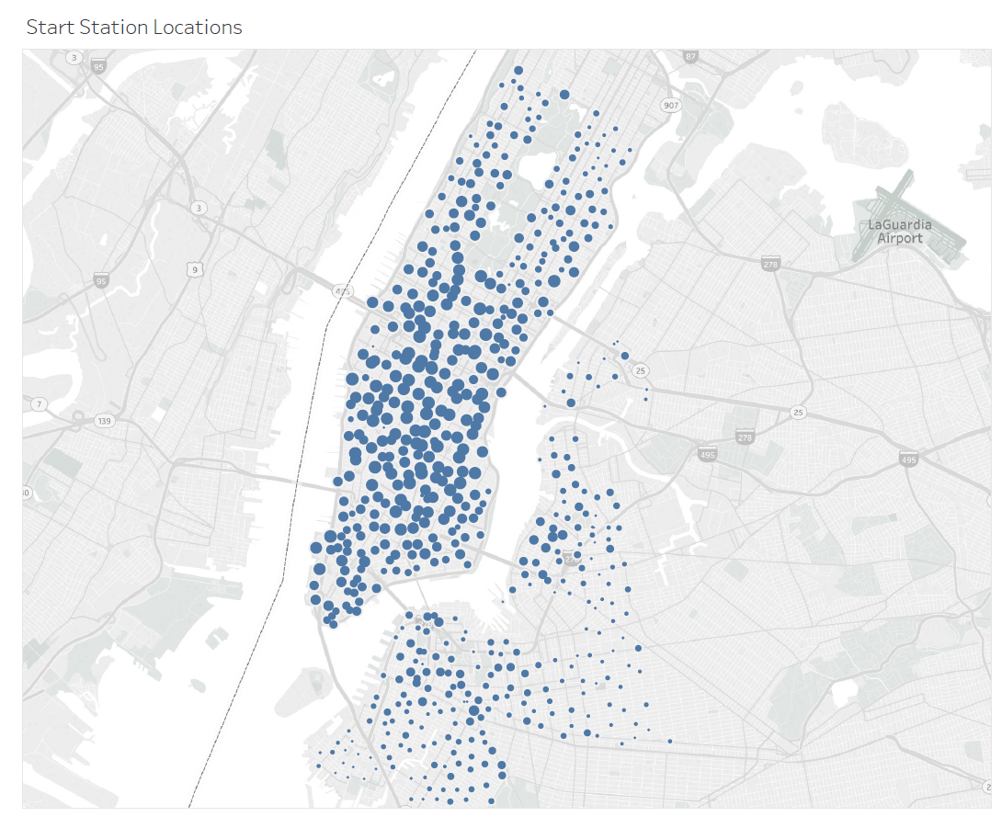
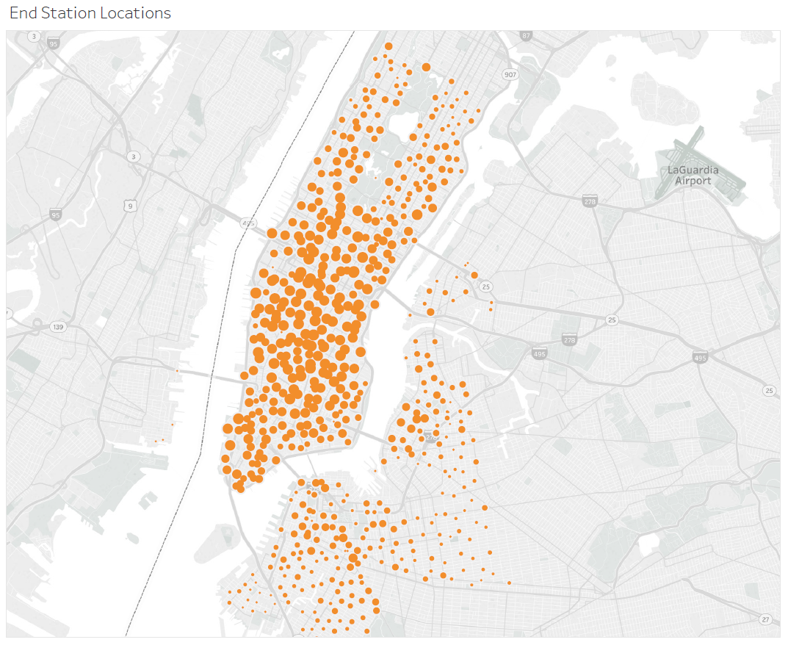
Trips by Station Location
Most trips clustered in Manhattan
Larger circles represent more trips at the station

Slide 4
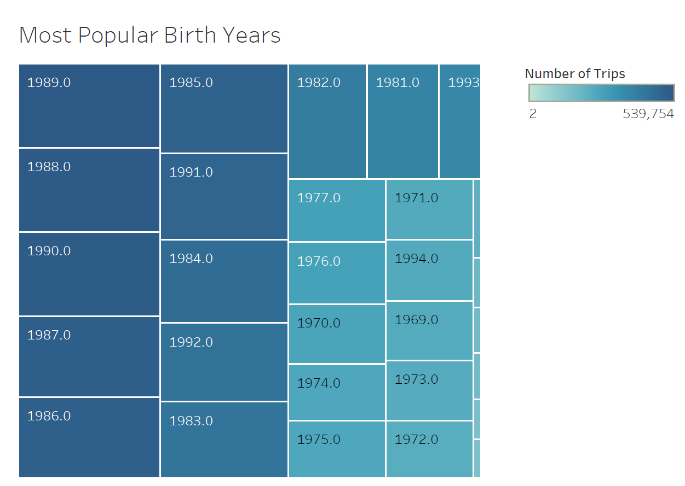
Users by age
Citi Bike’s most active riders are between 25 and 35 years of age
Correlates with national data on car ownership, i.e. millennial gen less likely to own a car

Slide 5
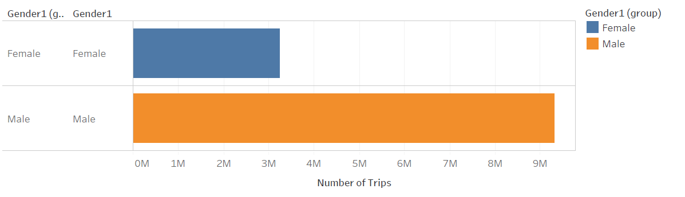
Trips (Male vs Female)
Males outnumber female riders 3 to 1
Perhaps males do indeed use Citi Bike much more than females, but there is a good chance this might be explained by the app design
I.E. male may be the default gender and many users elect or forget to update it

Slide 6
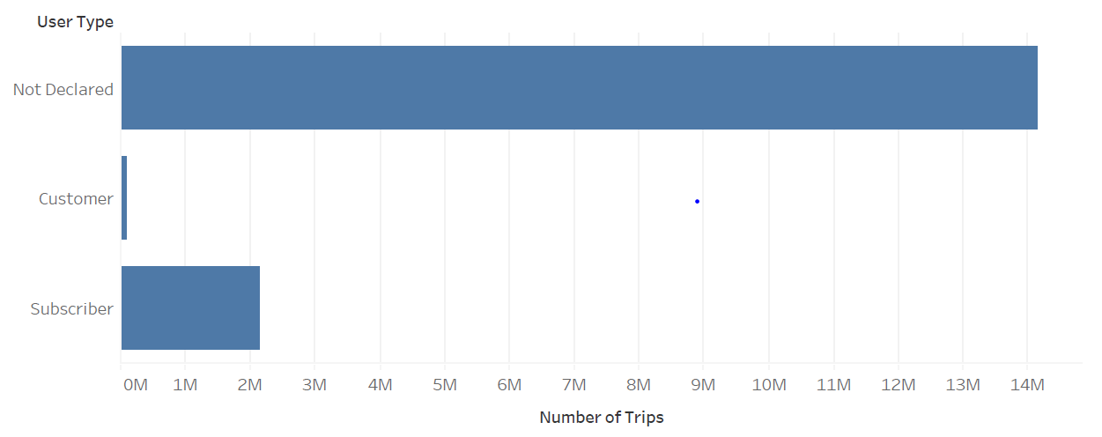
Trips (Users vs Subscribers)
The vast majority (over 85%) of users are not subscribers
Subscribers make up only 10-15% of users

